Slide 1


Introduction to
Robotic Process Automation
ERP ATTENDANCE MONITORING AUTOMATION
220701251
Sanjeevan Hari Sudhakar
Mr. Duraimurugan .N
Assistant Professor (SG), CSE

Slide 2
Abstract
The ERP Attendance Monitoring Automation is an innovative Robotic Process Automation (RPA) solution designed to streamline and optimize the process of attendance tracking and reporting in educational institutions. Developed using UiPath, this system automates the manual, time-consuming tasks of logging into the ERP portal, extracting attendance data, organizing it into structured Excel reports, and emailing the reports to students. By leveraging the power of automation, the system ensures accuracy, consistency, and efficiency while significantly reducing human effort.

Slide 3
Need for the Proposed System
This project addresses common challenges in attendance management, such as errors in manual data handling, delays in communication, and the repetitive nature of the process. It provides an automated, end-to-end solution that enhances the efficiency of administrative workflows and ensures timely dissemination of critical information to students.

Slide 4
Advantages of the Proposed System
By automating these tasks, the system not only saves time but also improves accuracy and reliability, empowering educational institutions to focus on more meaningful academic and administrative goals. The ERP Attendance Monitoring Automation showcases the transformative potential of RPA in education, paving the way for broader adoption of automation technologies in academic environments.

Slide 5
Literature Survey
The Role of Robotic Process Automation in Streamlining Administrative Tasks in Educational Institutions | Leveraging Robotic Process Automation for Attendance Management in Higher Education
This paper discusses how RPA automates administrative tasks in educational institutions, including attendance management, grading, and scheduling, using tools like UiPath. It emphasizes the reduction of manual effort and the improvement of data accuracy. | This study focuses on using RPA for attendance management, including automating the tracking, reporting, and notification processes, as well as detecting absenteeism patterns using AI-driven bots.
Advantages
Time Efficiency, Error Reduction, Scalability, Cost Savings | Real-Time Monitoring, Enhanced Engagement, Consistency, System Integration
Disadvantages
High setup cost, Employee Resistance, Maintenance Complexity | Technical Challenges, Data Privacy, Limited Flexibility

Slide 6
Main Objective
The ERP Attendance Monitoring Automation aims to revolutionize the process of attendance tracking and reporting in educational institutions by leveraging the capabilities of Robotic Process Automation (RPA). This system is designed to replace manual methods with a fully automated workflow that enhances efficiency, accuracy, and timeliness. The primary objective is to streamline the process of extracting attendance data, generating reports, and sending them to students via email, thereby reducing human effort and minimizing the risk of errors. Ultimately, the objective is to deliver a robust, user-friendly solution that enhances the experience for both students and administrators.

Slide 7
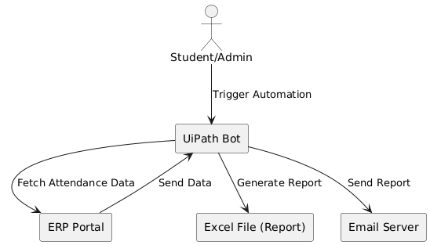
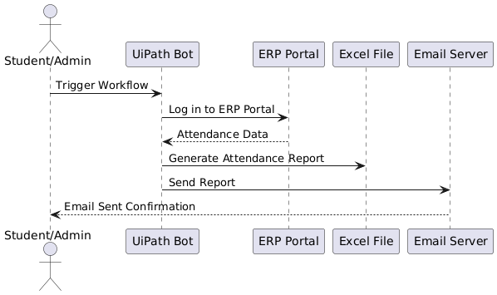
Architecture

Slide 8
System Requirements
Hardware:-
Processor Intel i5 (min), Intel i7 (recommended)
RAM 8 GB (min), 16 GB (recommended)
Storage 256 GB SSD (min), 512 GB SSD (recommended)
Software:-
Operating System Windows 10 or Windows Server
UiPath Studio Latest Version
UiPath Robot For running automation
Microsoft Excel Excel 2016 or later
Email Client Outlook, Gmail, SMTP
ERP Portal Web-based portal with login credentials
Browser Chrome/Firefox

Slide 9
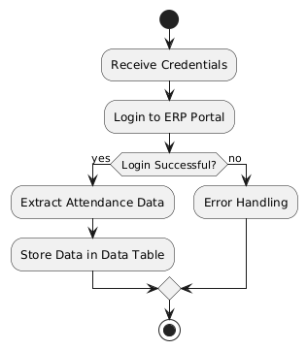
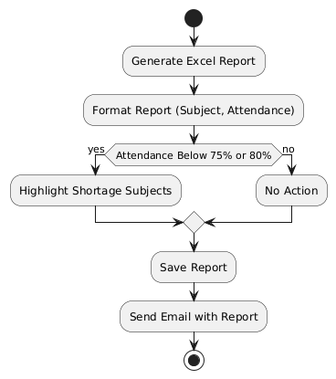
Functional Description
Module 1 - Login and Data Extraction | Module 2 - Report Generation and Email Communication
Automates the login process to the ERP portal. Retrieves attendance data (subject, classes attended, percentage). | Generates Excel reports with attendance data. Sends reports via email to students.

Slide 10
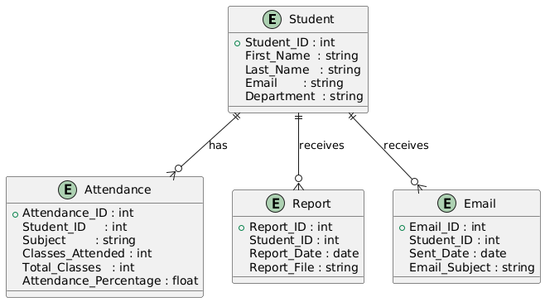
Table Design

Slide 11
Process Design
Main Process:
Login to ERP Portal
The bot logs into the ERP portal using provided credentials.
Extract Attendance Data
Retrieve attendance data for each student (subject, classes attended, total classes, percentage).
Generate Report
Organize the extracted data into a structured Excel report.
Send Report via Email
The system automatically sends the report to the student’s email with the attached Excel file.
Sub-Processes:
Sub-Process 1: Validate Login Credentials
Verify the correctness of the username and password before logging in.
Sub-Process 2: Extract Attendance Data
Navigate to the attendance section of the ERP portal.
Retrieve data such as subjects, classes attended, and total classes for each student.
Sub-Process 3: Format Attendance Report
Format the data into a structured Excel sheet, including headings and thresholds for attendance percentages.
Sub-Process 4: Send Email Notification
Automatically draft and send an email to the student with a personalized message and attached report.

Slide 12
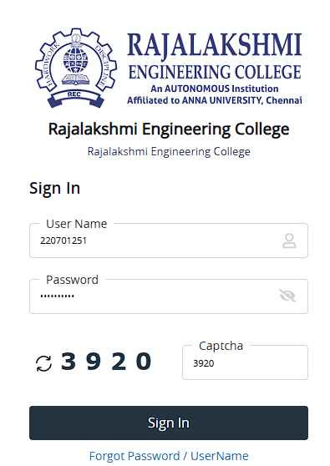
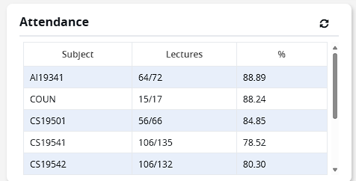
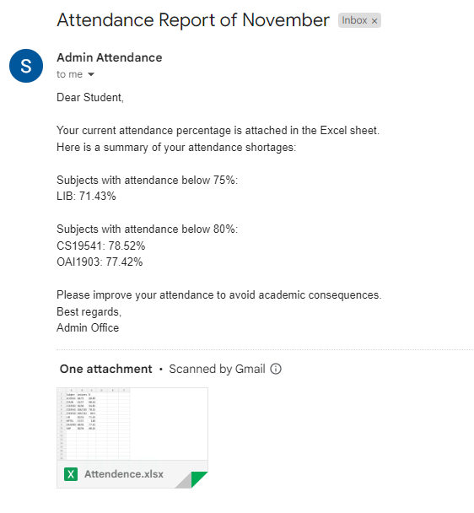
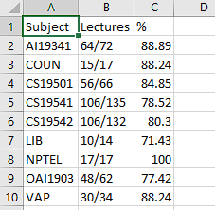
Implementation
Module 1: Login and Data Extraction
Automates login to ERP portal with Type Into and Click activities.
Extracts attendance data (Subject, Classes Attended, Attendance Percentage) using Data Scraping.
Stores the data in a DataTable for reporting.
Module 2: Report Generation and Email Communication
Formats attendance data into an Excel report.
Highlights subjects below 75% or 80% attendance.
Sends the report to students via email using Send SMTP Mail.

Slide 13
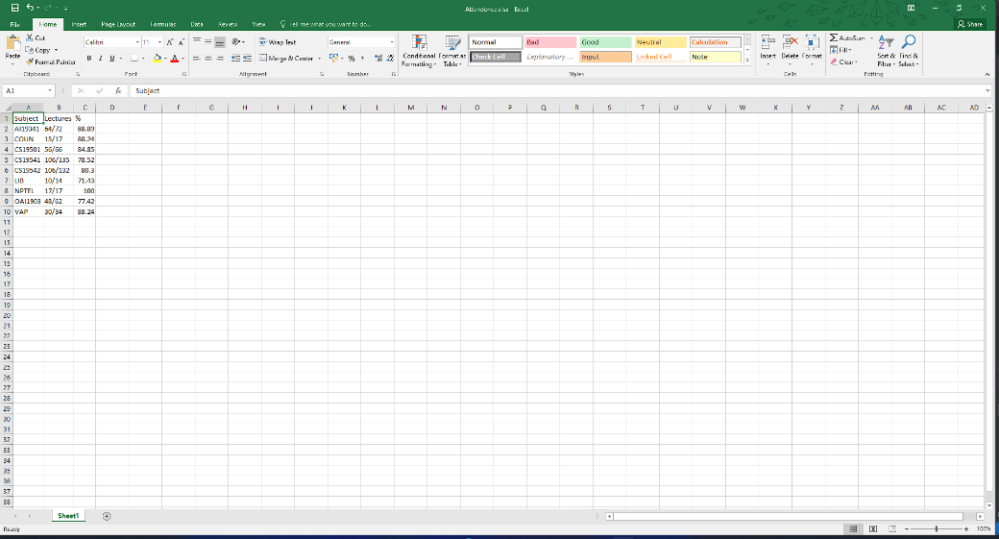
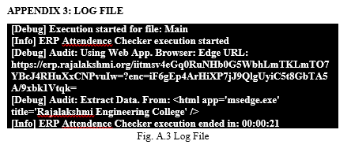
Testing
The Testing phase ensures that all components of the Automated Attendance Management System function correctly. It includes verifying the login process, extracting attendance data accurately from the ERP portal, and ensuring the Excel report is correctly generated. The system is also tested for its ability to send emails with the generated report attached. Testing involves both manual testing to simulate user interactions and automated tests to validate the complete workflow, ensuring no errors and confirming that students receive their reports accurately and on time.

Slide 14
Conclusions
The Automated Attendance Management System successfully streamlines the traditionally manual tasks of attendance tracking, report generation, and communication with students. By leveraging Robotic Process Automation (RPA) with UiPath, the system ensures greater efficiency, accuracy, and timeliness in handling attendance data. The automation of data extraction, report formatting, and email distribution reduces administrative workload, minimizes human error, and ensures that students receive real-time feedback on their attendance status. Overall, this system enhances operational productivity in educational institutions while providing students with accurate and timely attendance reports, making it an invaluable tool for modern educational administration.

Slide 15
Future Enhancement
Integration with Learning Management Systems (LMS): The system can be further enhanced by integrating with LMS platforms (e.g., Moodle, Blackboard) to automate the extraction of attendance data directly from class activities, online lectures, and assignments. This will allow the system to provide a comprehensive view of student engagement, not only based on physical attendance but also participation in online activities.
Real-time Notifications for Students and Faculty: An enhancement could include real-time notifications for both students and faculty regarding attendance updates. For instance, students can be alerted if their attendance falls below a certain threshold, or faculty members can receive notifications about students' attendance patterns. This would enable timely interventions and improve overall student engagement and attendance management.

Slide 16
IEEE Paper
"Robotic Process Automation in Education: A Review“
Authors: R. K. Gupta, S. K. Gupta, and R. S. Verma
"Automating Academic Administration with Robotic Process Automation: A Case Study“
Authors: M. Singh, V. Kumar, and S. Patel

Slide 17
References
Bhattacharyya, S. and Sarker, S. (2021) ‘Leveraging Robotic Process Automation for Improving Administrative Efficiency in Higher Education’, Journal of Educational Technology and Management, Vol.27, No.1, pp.14-25.
Gupta, A. and Sharma, R. (2020) ‘The Role of Robotic Process Automation in Streamlining Attendance Management’, International Journal of Information Technology, Vol.15, No.4, pp.79-90.
Patel, M. and Kumar, R. (2019) ‘Automation in Education: The Future of Academic Administration’, Educational Technology and Society, Vol.22, No.3, pp.32-45.
Singh, P. and Verma, M. (2021) ‘Enhancing Educational Operations Through Robotic Process Automation: A Case Study Approach’, Journal of Educational Administration and Technology, Vol.18, No.2, pp.47-61.
UiPath. (2021) ‘UiPath Studio Documentation’, UiPath Official Documentation, https://docs.uipath.com/studio/docs.
Wang, J. and Zhou, H. (2020) ‘Exploring Robotic Process Automation in the Management of Academic Systems’, Journal of Robotics and Automation, Vol.16, No.1, pp.23-36.
Zhang, L. and Liu, Y. (2022) ‘Automation and Artificial Intelligence in Education: Transforming Administrative and Pedagogical Practices’, AI & Education Journal, Vol.8, No.3, pp.102-115.

Slide 18
Queries

Slide 19
Demonstration

Slide 20
Thank You

